Slide 1
Reinforcement Learning (CMPE-260) - Project
By,
Shashank Raghuvanshi

Slide 2
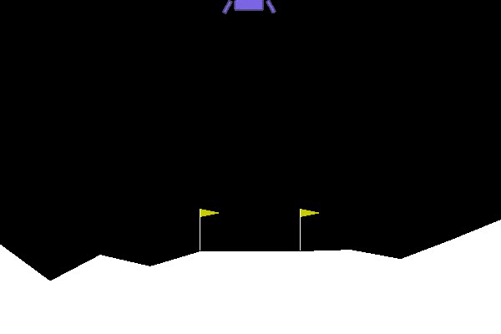
1
Lunar Lander-V2
Open AI Gym Environment

Slide 3
State Space
State Space has 6 continuous values (ranging from -inf to inf), and 2 boolean values
s[0] is the horizontal coordinate
s[1] is the vertical coordinate
s[2] is the horizontal speed
s[3] is the vertical speed
s[4] is the angle
s[5] is the angular speed
s[6] 1 if first leg has contact, else 0
s[7] 1 if second leg has contact, else 0
<number>

Slide 4
Action Space
Action Space has 4 discrete values
Do nothing
Fire Left Engine
Fire Right Engine
Fire Main Engine
Firing the left and right engines introduces a torque on the lander, which causes it to rotate, and makes stabilizing difficult
<number>

Slide 5
SARSA Algorithm
Q ( S , A ) = Q ( S , A ) + α ( R + γ Q ( S ' , A ' ) − Q ( S , A ) )
<number>

Slide 6
State Discretization
80 discrete values for horizontal coordinates between -2 and +2
40 discrete values for every other continuous values
It's still 8192000000 possible discrete state combinations!
Gadgil, S., Xin, Y., & Xu, C. (2020). Solving The Lunar Lander Problem under Uncertainty using Reinforcement Learning. arXiv [cs.LG]. Opgehaal van http://arxiv.org/abs/2011.11850
<number>

Slide 7
SARSA Train Parameters
Trained with 10000 episodes
Epsilon value of 1, with decay of 0.99, min value of 0.01
Learning rate 0.1
Agent explored roughly about 40k state combinations in total
<number>

Slide 8
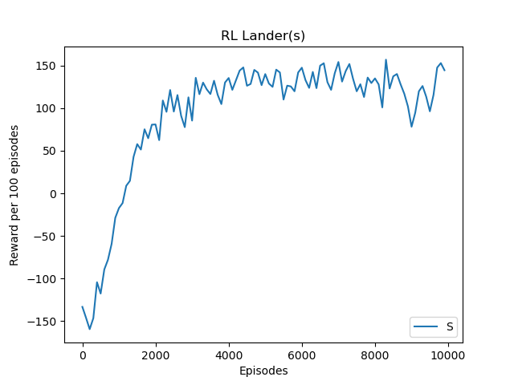
<number>

Slide 9
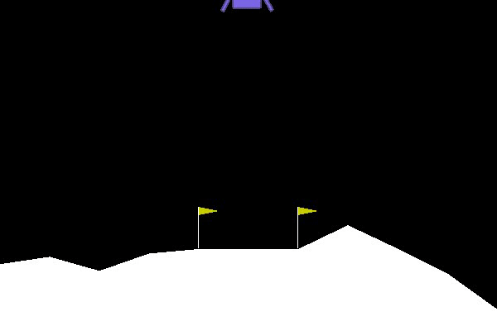
<number>

Slide 10
DQN Algorithm
<number>

Slide 11
DQN Train Parameters
Set reward threshold of 150 (stop training if the reward threshold is reached)
Evaluated by calculating mean reward on 100 episodes, mean 156.96 with standard deviation of 79.64
<number>

Slide 12
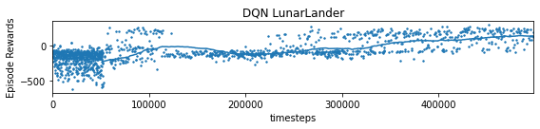
DQN Training
<number>

Slide 13
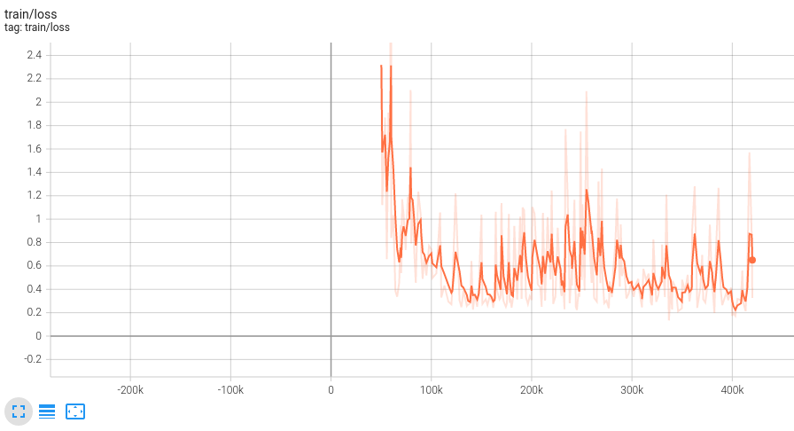
DQN Training
<number>

Slide 14
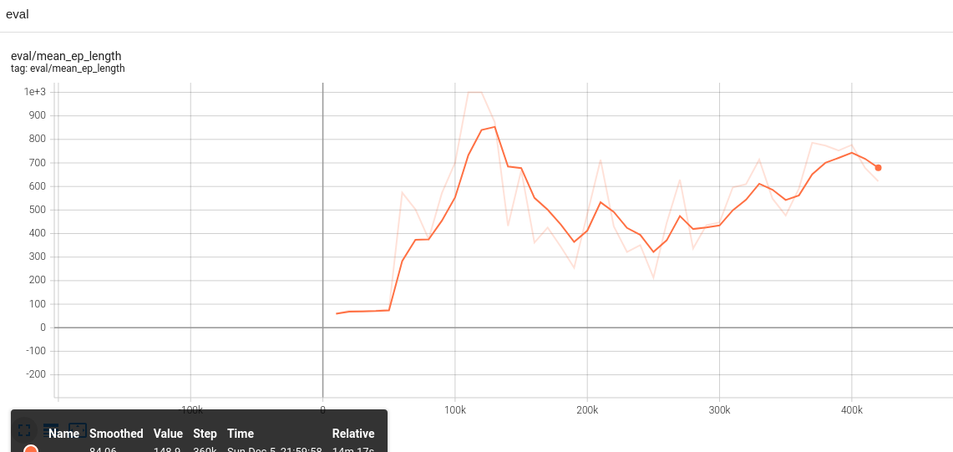
DQN Training
<number>

Slide 15
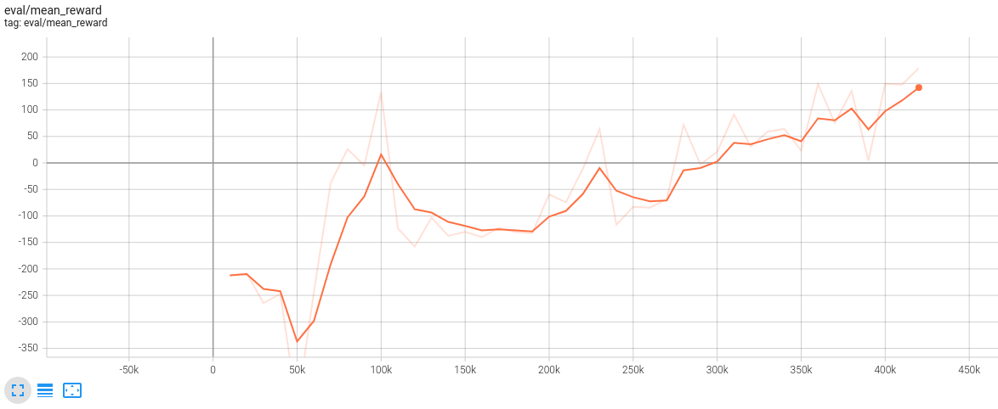
DQN Training
<number>

Slide 16
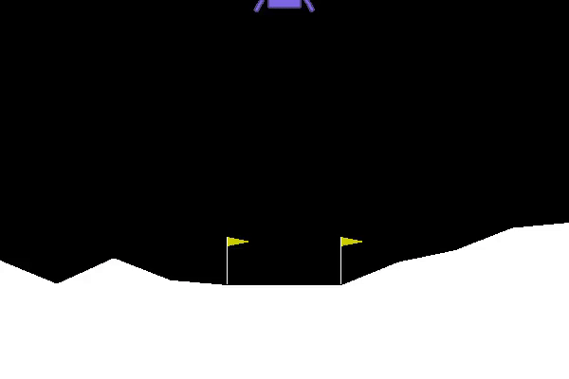
<number>

Slide 17
PPO Algorithm
<number>

Slide 18
PPO Train Parameters
Set reward threshold of 180 (stop training if the reward threshold is reached)
Trained for about 600 k steps
Evaluated by calculating mean reward on 100 episodes, mean 173.02 with standard deviation of 83.44
<number>

Slide 19
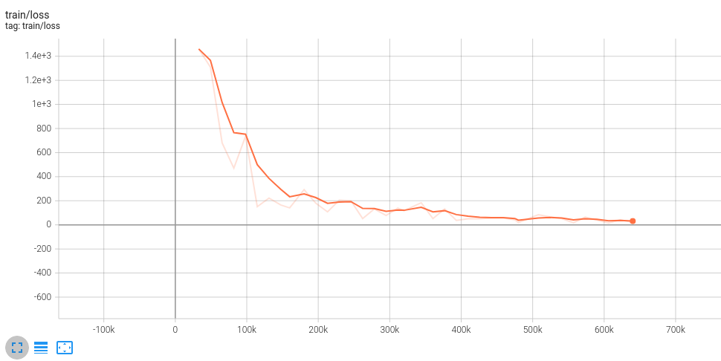
PPO Training
<number>

Slide 20
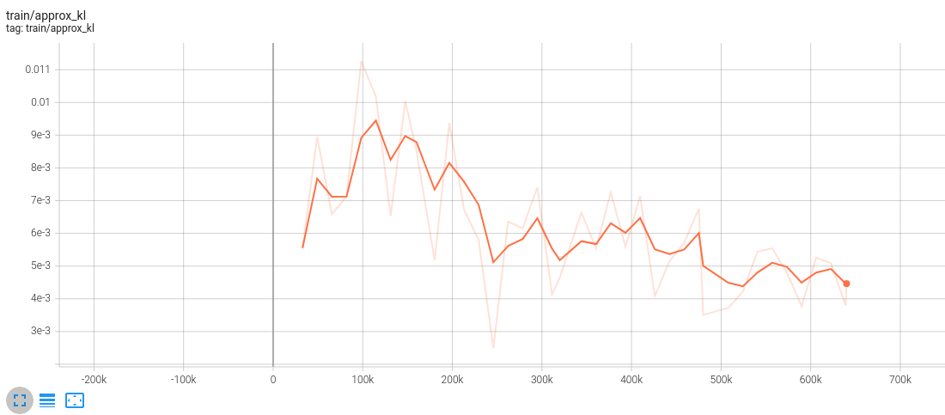
PPO Training
<number>

Slide 21
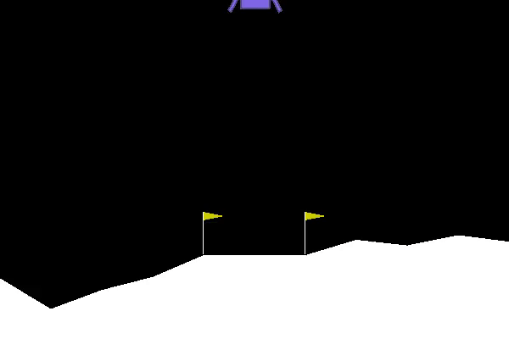
<number>

